Slide 1
Corporate Social Responsibility
The World Business Council for Sustainable Development (WBCSD) defines
social responsibility
as “the business
obligation to contribute to sustainable economic development, working with employees, their families, the local community and society at large to improve quality of life”.

Slide 2
ECM’s Commitment to SOCIAL RESPONSIBILITY
we believe in social responsibility. we pride ourselves in investing in our MOST VALUABLE ASSET,
OUR PEOPLE.
Our company culture exemplifies
our values and mission.
impact is at the heart of our approach to business.

Slide 3
ECM’s Social Footprint
Hiring local
Train the trainer
Philanthropy
Support local and global causes
Environmentally friendly
Sustainability
Create and foster new relationships among key stakeholders

Slide 4
WHAT WE DO
In addition to the services we provide, we also create social impact strategies for our projects
We use data to identify social needs of a geographical location
These solutions range from wellness initiatives, and work Sustainability to education.

Slide 5
SOME OF OUR PARTNERS

Slide 6
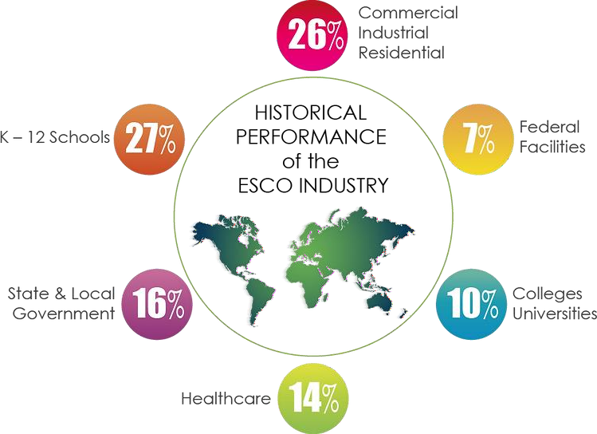

Slide 7
ECM’s Social Footprint
Hiring local
Train the trainer
Philanthropy
Support local and global causes
Sustainability
Environmentally friendly
Create and foster new relationships among key stakeholders

