Slide 1





Comprehensively
Protecting
Critical
Infrastructure in Africa
Presented by: The ECM Team
Summer 2022

Slide 2

ECM Team Overview (1)
Introducing ECM / HITI / RAVE:
Founded in 2010 as a Small Business provider of Security Consulting & FMS services to F-16 projects for the Pakistani Air Force & Iraqi Air Force.
Facility HQ Location: Largo, FL.
Facility Clearance: Top Secret.
ISO 9001:2015 Compliant (Quality Management Systems)
ISO 18788: 2015 Compliant (Mgmt. for Private Security Ops)
NIST SP 800-171r2 Cybersecurity compliance
We Offer :
Access Controls
Decision Making Systems
Contact Intent Determination
Inspections
Intrusion Responses
Operations Centers
Rapid Threat Analyses
Remote Intrusion Detection
Secured Sites & Installations
Security Surveillance
Stand Off Perimeter Protection
Wide Area Alerts
1

Slide 3
ECM Team Overview (2)
Introducing Sapphire BLU:
Sapphire BLU has 15 years of global experience providing a wide range of Systems Engineering, Technical Assistance & Advisory & Assistance Services solutions. They rapidly deploy advance technologies into defense environments in order to solve complex challenges.
Facility HQ Location: Las Vegas, NV with 2 other US locations.
NAICS code: Primary 541330, 541512, 611430​
Contract capability types FFP/CP/CPFF​
Certified DCMA financial system
Cybersecurity Maturity Model Certified (CMMC) Third Party Assessor Organization (C3PAO)
We Offer :
Systems Engineering
Project Management
Research & Development
Cybersecurity
System Integration
Architecture & Engineering (A&E)
Cybersecurity Training Support
Systems Administration
Electronic Warfare
Mod & Sim
Tactical Data Links
CMMC Assessments & Consulting Services.​
2

Slide 4
ECM Team Overview (3)
Introducing CRI Universal Solutions (CRI USO):
CRI USO is a corporate offshoot & major global expansion of CRI Training Inc. (CRI) that was originally formed in 2000 in Las Vegas, Nevada, USA. The firm has done business on 5 continents & now has 8 distinct corporate divisions Its mission is to save lives, support livelihoods & create success for others through a wide range of products & services involving technologies & training.
Facility HQ Location: Las Vegas, NV with staff near Washington DC
We offer:
Clandestine Operations Planning & Architecture
Counter Maritime Piracy
Cybersecurity & Hi-Tech Training Academy (23 courses with certificates awarded upon completion)
Explosive Detection K9s
Military & Special Forces Training for Combat
Online Video Courses (Defense Against Active Shooters & Terrorists/Terrorism)
Police Training Academy (Basic & Advanced Levels)
Remote Medical Services Technologies
Tactical Drone Academy
Training courses to develop professional: Bodyguards, Executive Protection Specialists, Private Security Detail (PSD) Operators
Vocational School (8 Tactical-focused programs)
3

Slide 5
ECM Team Overview (4)
Introducing ADT Commercial
ADT Commercial provides clients with the security industry knowledge, hi-tech equipment, & quality of service they need to successfully manage their security programs consistently & effectively across all locations.
Facility HQ Location: Boca Raton, FL.
We Offer :
Extensive industry experience with national & local presence.
A tailored security approach for each client’s site using state-of-the-art hi-tech equipment installed by thousands of highly-trained & very experienced technicians.
The industries we serve include:
Banking & Financial Services
Commercial buildings
Education
Energy & Utilities
Food & Beverage
Healthcare
Hospitality
Industrial
Pharmaceutical
Professional Services
Restaurant
Retail
Telecommunications
Transportation & Logistics
4

Slide 6
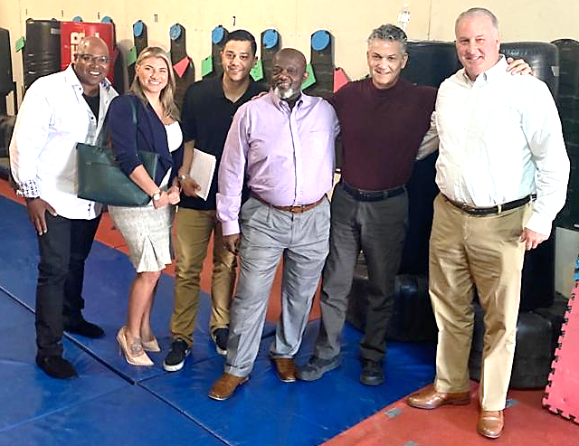
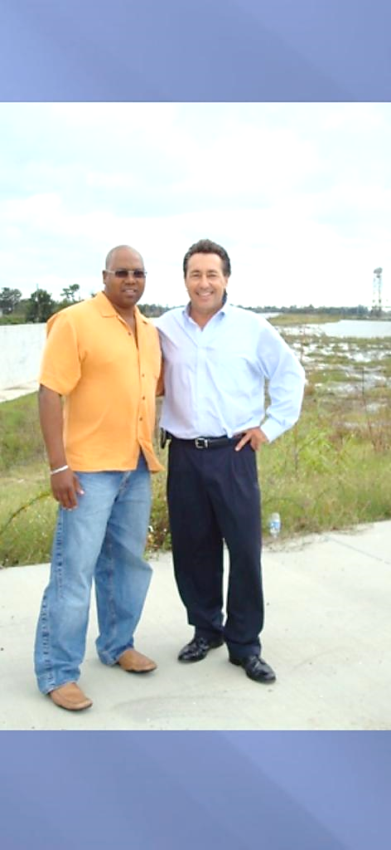
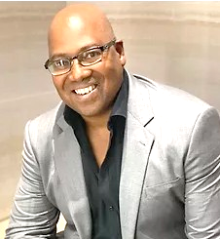
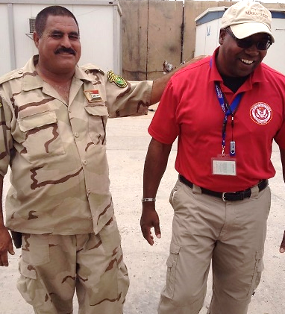
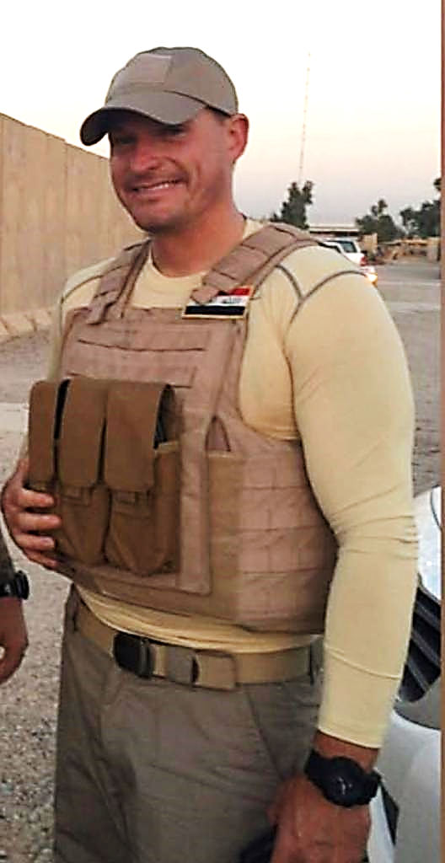
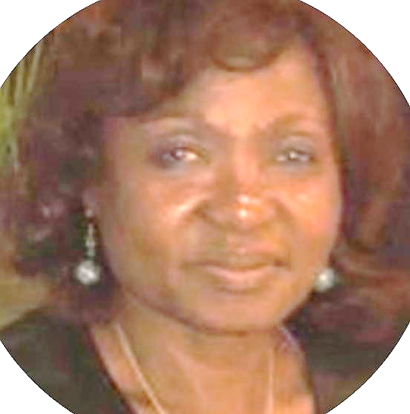
ECM Team Overview (5)
Robert E. Oakley, Jr.
Founder & CEO
Dr. Verona Parkinson.
Executive Director
RAVE & AGEMA
Maputo
5

Slide 7
ECM Team Overview (6)
ECM is led by Founder & CEO, Mr. Robert E. Oakley Jr. The firm has developed & managed several environmentally-aware construction projects, & will continue to do so in efforts to help save our planet with sustainable construction.
Our branch in Maputo is headed by Dr Verona Parkinson, who specializes in Food Security & Nutrition, Agricultural Advisory Services, & Climate Change. Verona has significant international development knowledge & fieldwork skills. She has managed large number of surveys & has proven project management skills. As Director of Projects at AGEMA Consultoria, she has coordinated & managed a wide range of multidisciplinary projects, scientific studies & evaluated projects funded by agencies such as the AfDB, CDKN, GAC, DANIDA, DfID. IDB, IFAD, JICA, UNDP & the World Bank. As Team Leader in Climate Change her studies encompass adaptation & mitigation in Mozambique, & she has presented several papers on the impact of climate change on food security at international conferences.
With 20 years work experience in Mozambique, she also supervised several project reviews & evaluations including IFAD’s programs in Cabo Delgado, Nampula & Maputo provinces. Dr. Parkinson further reviewed Regional Technical Assistance IFAD Grants, managed & led the final evaluations of two USAID programs in Sofala, Manica, Tete & Niassa provinces & a JICA funded project in Niassa province. She also coordinated evaluations of projects on water, sanitation & public health.
Verona is currently coordinating the mid-term evaluation of the VIVA program funded by the Global Fund on HIV in three provinces in Mozambique & is the Team Leader for a stakeholder project on Resilience Food Security. She participated in a COVID-19 Regional Food Security & Livelihood Analysis in Mozambique & Angola. She has published scientific papers & is a reviewer for the African Journal of Agricultural Research, the African Journal of Biotechnology, & the International Journal of Water Resources & Environmental Engineering.
6

Slide 8
ECM Team Strategic Partners (1a)
Homeland Intelligence Technologies International, Inc. (HITI) is a small business operated by veteran's with a proven past performance track record providing professional security services worldwide to the U.S. Government and foreign governments.
Our services include but are not limited to: Security & Protective Services, U.S. Immigration Detainee Transport, Logistics & Supply Chain Security, Risk Management, Cybersecurity, and Planning & Executing Evacuations of Non- Essential Personnel during crises.
For over10 years, our company has provided professional security services to the U.S. Government. We support the protection of significant military equipment / technologies transferred by foreign military sales and co-production agreements to Foreign Governments as well.
7

Slide 9
ECM Team Strategic Partners (1b)
Our Programs
F-16 Pakistan Air Force (PAF): 1st DoD Technical Security Team Program
Developed, designed & implemented PAF F-16 security programs & electronic/video security systems. Provides U.S. Government required enhanced end-use monitoring & on-site training of PAF security personnel. Also developed a full video library for use by future recruits for rapid familiarization to the base security operations.
F-16 Iraqi Air Force: 2nd DoD Technical Security Team Program
Provided mentorship and oversight to 60+ IqAF officers and 1300+ enlisted personnel. Also conducted 22,000+ program evaluations, program management reviews & security exercises to ensure compliance with U.S. Gov’t. security requirements that led to the successful delivery of F-16 aircraft. Developed, trained & supervised the execution of the IqAF Base Defense Plan for Balad Air Base to support the requirements of foreign military sales case.
ICE Air Operations
Scheduled Large Aircraft Charters & Special High-Risk Charters daily. Assisted in the coordination of deportation missions with ICE regional offices, contractor pilots, aircraft mechanics, flight attendants, &medical/security personnel. Conducted preflight checks, monitored & coordinated ICE Air Operations mission & streamlined communication between all parties. Conducted 1000+ aircraft missions with 100% safety & security compliance.
8

Slide 10
ECM Team Strategic Partners (2a)
CRI USO Main Divisions: A to E
Aviation Division
Includes UAS Integration Centers, Tactical Drones, Tactical Drone Academy, & Drone Academy.
Bio/Technological Medical Division
Methodologies & technologies for defense against infectious diseases, & technologies to save lives & enhance human wellness.
Cyber Division
Offers a variety of training programs & cybersecurity services that incorporate cutting-edge cyber technologies from Israel.
Emergency Services Division
Training & services in Chemical, Biological, Radiological, & Nuclear (CBRN) defense for various government agencies & the public.
9

Slide 11
ECM Team Strategic Partners (2b)
CRI USO Main Divisions: P to R
Public Safety Division
Provides training in homeland security, national security, anti/counter terrorism, crime defense, & tactical drone use.
R&D Innovation Division
Delivers technological innovations & solutions that can save lives, enhance quality of life, and create amazing investment opportunities.
10

Slide 12
ECM Team Strategic Partners (2c)
CRI USO Drone Courses
Drone Pilot Courses & Tactical Teams Courses
Drone Pilot & Tactical training courses offer the best options for entire units/groups
Law Enforcement, Military, Federal & Security Drone Courses
CRI’s Tactical Drone Academy offers one-of-a-kind tactical drone courses that in the fields of public safety, homeland & national security in support of our national safety & readiness.
PTSD/TBI Drone Experience Courses
These rehab-oriented courses are offered to veterans and trauma survivors.
Public Drone Courses
Drone training courses are offered to qualified & vetted civilians interested in pursuing careers within the drone industry.
Tactical Drone Advisement, Consultation, & Guidance
Delivers advisement, consultation & guidance services to law enforcement, military units, federal agencies, & security companies creating & implementing tactical drone units/divisions within their respective agencies or departments.
11

Slide 13



ECM Team Strategic Partners (3)
for Physical Security
RAVE / HITI / CRI USO / ADT Commercial provide exceptional security equipment & specialists that deliver unprecedented physical security solutions.
Physical Security Solution Examples
Executive Protection Services
Personnel / Vehicle / Cargo Screening Services
Special Event Security Services
Access Control Services
RAVE/ HITI /CRI USO / ADT Commercial Security Specialists can also develop tailor-made security plans & programs while applying the most current industry standards / requirements at the customer’s request
12

Slide 14
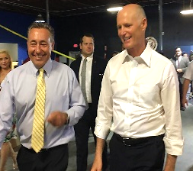


ECM Team Strategic Partners (4)
for Personal Security
RAVE/ HITI / CRI USO Personal Security: Manpower + Equipment mitigates risk for people whose reputations, prominence, wealth, travel, or jobs require heightened security.
Personal Security Solution Examples
Secure Travel Services: provides security drivers, vehicles & protective personnel as needed globally through our own staff or carefully vetted partners. Traveler tracking & emergency evacuations are also included.
Close Protection Services: as needed at home, at work or on the road- including protective surveillance & covert protection.
Residential Protection: to keep principals & their families safe at primary or secondary residences.
Consulting, Development & Implementation of Corporate Executive Protection: programs so corporations can build, turn around, or improve their own dedicated EP programs. We conduct Risk, Threat & Vulnerability Assessments (RTVAs) to program design, staffing & management.
Emergency Protection Services: that are available on short notice to deal with evacuations and other crisis situations.
13

Slide 15

ECM Team Strategic Partners (5)
for Cybersecurity
Sapphire BLU provides cost-effective, competitive pricing for exemplary tailor-fitted cybersecurity services & support.
Cybersecurity Solution Examples
Incident Response, Mitigation, Remediation, & Recovery
Insider Threat Hunting
Malware Analysis
Monitoring & Analysis (7x24x365)
Network Traffic Monitoring
Pattern Analysis
Penetration Testing
Trend Analysis & Correlation
Vulnerability Assessments
Web & Communications Log Capture & Analysis
Asset Discovery & Management
Attack Sensing & Warning
Communications & Coordination
Cybersecurity Application Development, Deployment, & Integration
Cybersecurity Infrastructure Architecture & Engineering
Cybersecurity Infrastructure Operations, Maintenance, & Administration
Cybersecurity Program Management
Cyber Threat Intelligence
14

Slide 16

ECM Team Strategic Partners (6)
for Staffing
As trusted leaders in the staffing industry, we pride ourselves on providing tip- of-the-spear experienced professional personnel & leaders in various industries to uniquely fit every client’s mission.
Staffing Solution Examples
Areas include but are not limited to:
Physical Security Cyber Security Industrial Security Key Leadership
Technical Security Oversight Risk Management
Mentorship and On-Job Training Security Plans and Programs
Quality Assurance and Quality Control
Inspections
End User Monitoring Resource Protection
15

Slide 17
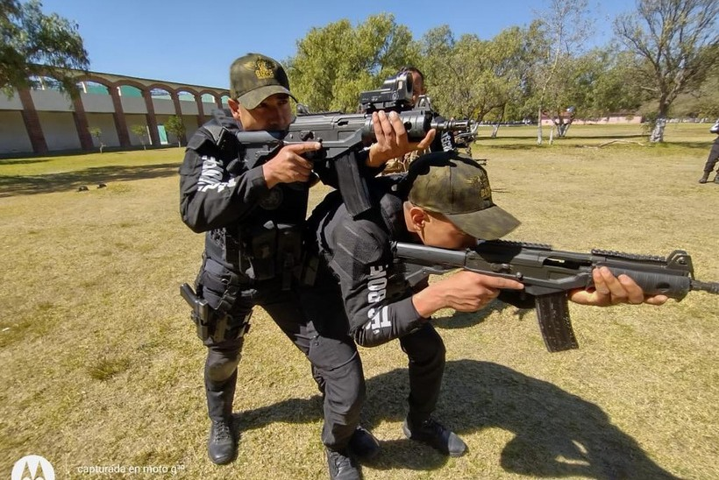
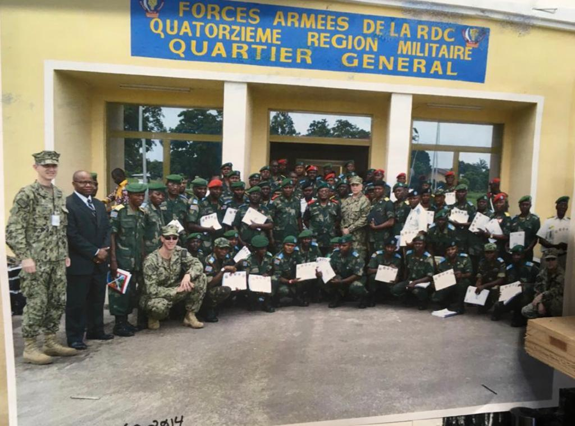
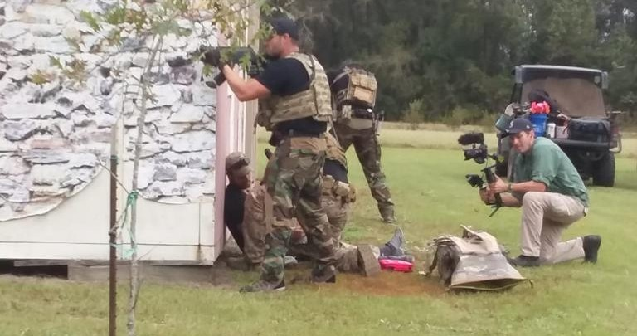
ECM Team Strategic Partners (7)
Henk Van Tonder, Global Security Expert
for Security
Training
&
Advanced Law Enforcement, Military, Security & Fire and Rescue Professional Training.
Security Training Solution Examples
Areas include but are not limited to:
Certified Instructors
Defensive Tactics
Firearms
First Responders
Force Protection
Technical Rescue
Weapon Defense
16

Slide 18
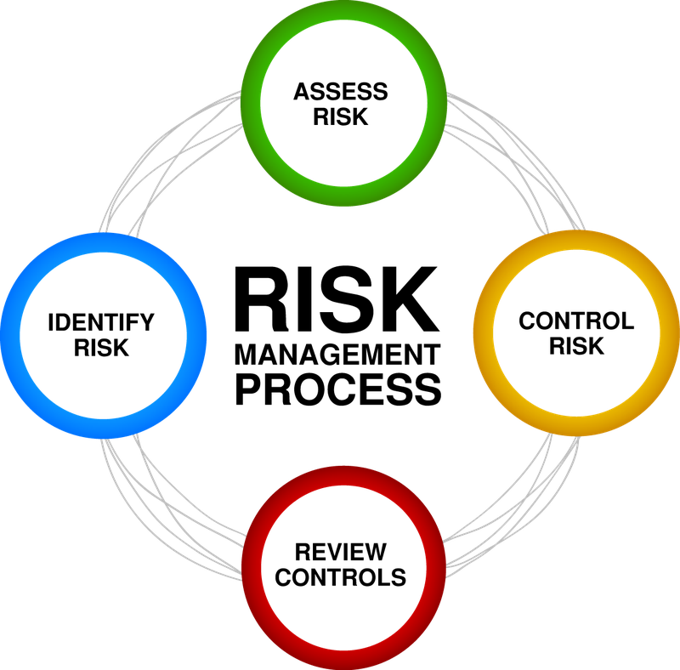
ECM Team Strategic Partners (8)
for Risk Management
RAVE / HITI / CRI USO assists organizations to implement effective & efficient risk management..
Risk Management Solution Examples
Collaborating closely with each client & their unique organizational requirements to build a trusting relationship as well as high degrees of confidence in the risk management process.
Obtaining high-quality risk-related information from clients & then applying it along with the proper Risk Management processes, tools, systems & cultures. This will enable each client to objectively manage, identify & mitigate their organizational & project risks so as to consistently realize best outcomes for all clients.
17

Slide 19
ECM Team Strategic Partners (9)
for Industrial
Security
RAVE/ HITI / Sapphire BLU / CRI USO can provide security services in accordance with the US National Industrial Security Program to assist companies or foreign governments in developing, administering & maintaining comprehensive security programs.
Industrial Security Solution Examples
Implement Department of Defense (DoD) security policies & procedures as directed by the DoD 5220.22-M (Industrial Security); DoD-M 5200.01 (Information Security, Volumes 1-4); & DoD 8500 series instructions for cybersecurity.
Conduct evaluation of existing security programs & operations to include security policies & procedures, personnel vetting, visitor controls, physical security equipment testing & evaluation (access controls, intrusion detection, & video monitoring systems), protection of intellectual property, & recommendations.
Assist staff, conduct self-inspections, & recommend corrective actions.
Perform facility security officer duties & responsibilities for small business operations.
18

Slide 20
Contact Information
In the USA:
Robert E Oakley
Chief Executive Officer
ECM /RAVE / HITI
roakleyecm@gmail.com
In Africa:
Dr Verona Parkinson
Executive Director
RAVE (AGEMA)
Roakley.ravesecurity@gmail.com
Tel: +258 214 97163
Rua de Tchamba 427, Maputo, Mozambique
19

